Slide 1
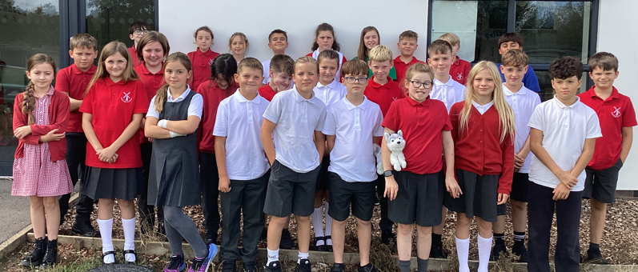
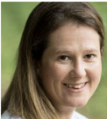
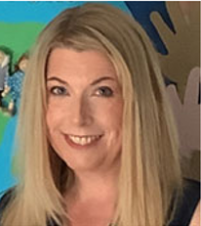
Meet the teacher
Miss Cuthbertson-Monday, Tuesday and Wednesday (am)
Mrs Mason-Wednesday (pm), Thursday and Friday
September 2026
Notes:
Class pic here

Slide 2

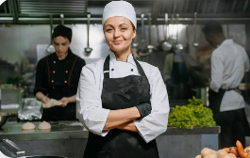


Our Learning this Term!
Reading-Letters from the Lighthouse
History-World War 2
Science-Evolution and Inheritance
D&T- Come Dine With Me

Slide 3
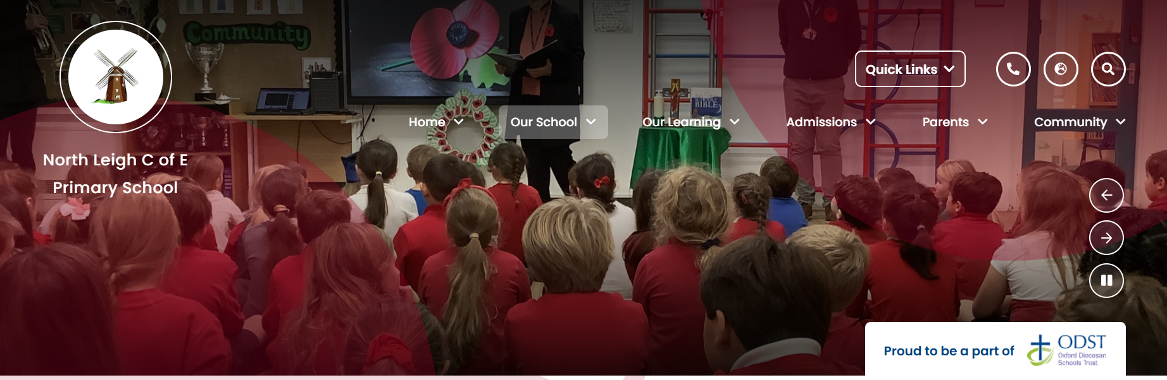

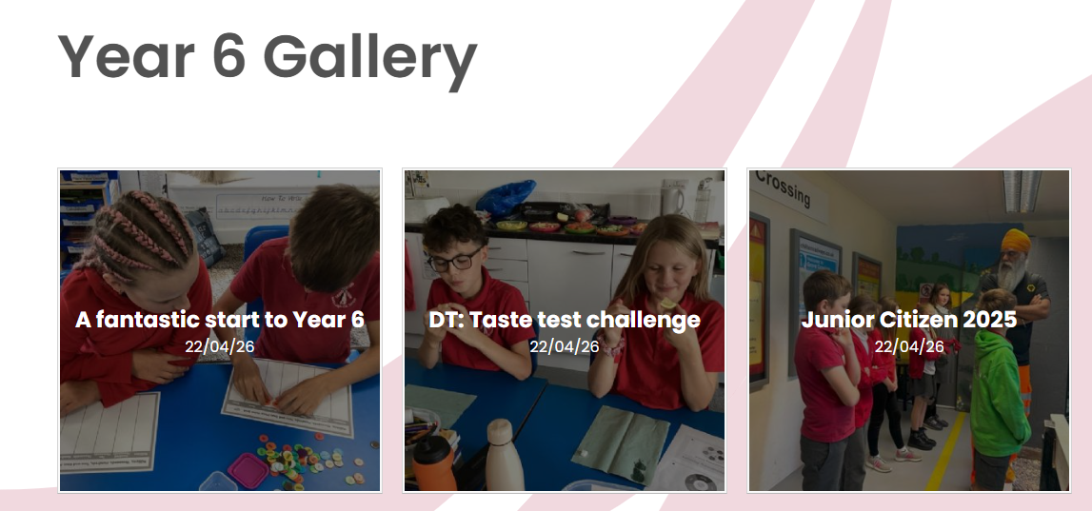
We’re looking forward to sharing our love of learning with you.
This will be through:
Galleries on our class website pages
Newsletters with photos and news from each class every other week on the school website.
North Leigh Instagram account.
We are also excited by our Autumn café assembly (date to be announced very soon) - when parents are invited to come and enjoy coffee, cake and listen to Owl class share something of their learning with you.
CELEBRATING LEARNING

Slide 4
Trips and Residential
We will be going to Junior Citizen in the Autumn term
Parents are invited to our Harvest assembly on the 2nd October
Our World War 2 Day will be a dress up day in school on 20th October
Christmas Panto will be Thursday 17th December
Kilvrough Residential will be taking place Monday 26th April-30th April-more information will be given nearer the time

Slide 5
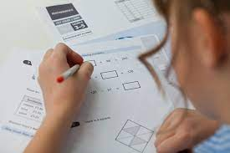
sats
SATs are not the focus of Y6 at North Leigh but just one part of it. Some children have expressed concern about SATs. Please be assured that we will prepare your children so that SATs are not a major hurdle and pass with the minimum of anxiety and hopefully a sense of achievement at being able to demonstrate their knowledge. In previous years, many Y6 children have included SATs week as one of the best weeks of Year 6!
More details will follow about the arrangements for SATs as the time approaches.
The 2026 dates are 10th-13th May.

Slide 6




You must apply by the deadline to OCC by 31.10.26 for a place at your preferred Secondary School
https://www.oxfordshire.gov.uk/residents/schools/apply-school-place/year-7-applications
Wood Green Open Evening is 24.09.26 5pm-8pm.
Wood Green Open Morning is 25.09.26 9am, 10am and 11am
Bartholomew Open Evening is 24.09.26 5pm-8pm
Henry Box Open Evening is 16.09.26 4:30pm -6:30pm
Marlborough Open Evening is 24.09.26 6pm onwards
Marlborough Open Morning 29.09.26/01.10.26 9am-10:30am
TRANSITION TO Y7

Slide 7
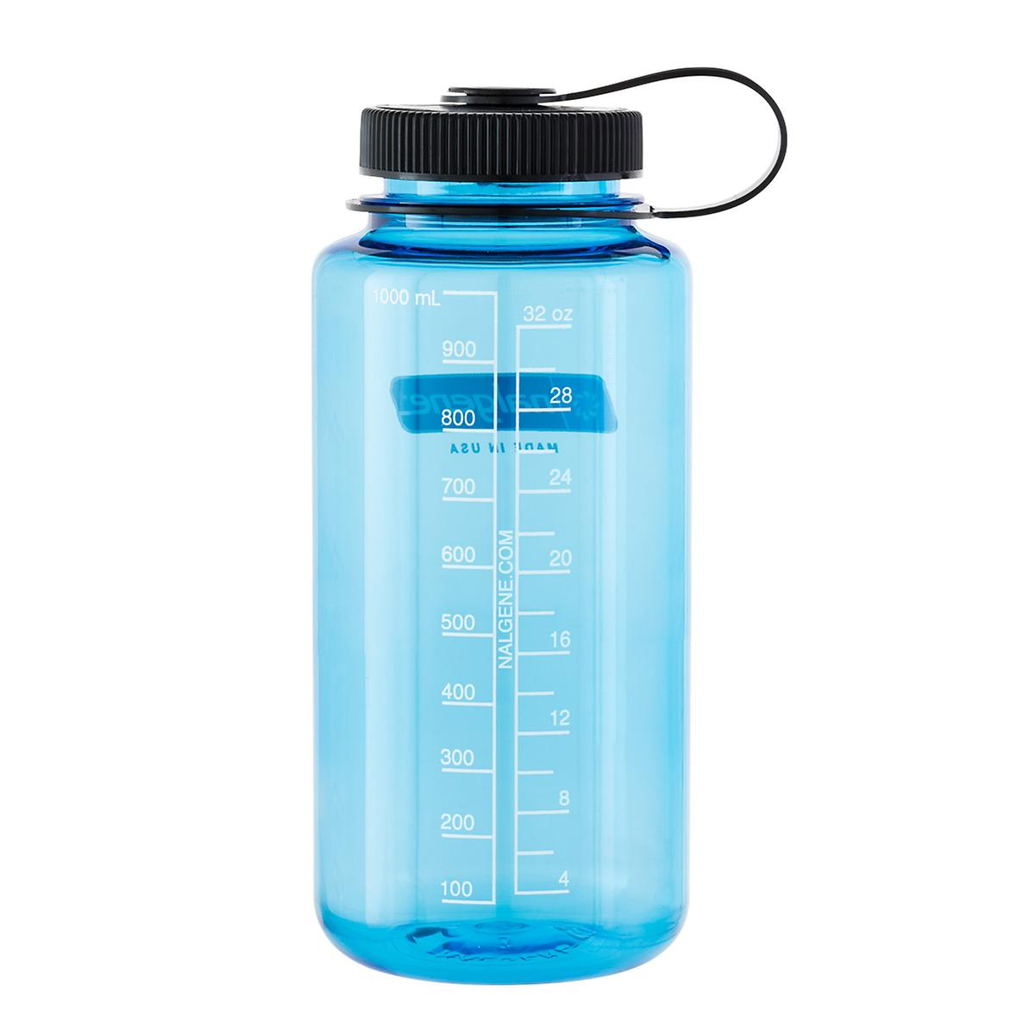

Daily Routines
Arrival from 8.30am (teachers on playground 8.35am collection at 8.40am from upper playground
Children need to bring a coat, school bag, (lunch bag),
water bottle and home school reading book
Please ensure children have water in their bottle, not juice.
Break is mid-morning and children are can bring in a snack – fruit, vegetables, cereal bar. Please try to reduce/avoid single-use plastic where possible. Crisps, chocolate or cake bars should not be eaten at breaktime.
Nothing with nuts in please: we are a nut-free school.
Long hair must be tied back each day.
Notes:
Fidget toys and things from home

Slide 8



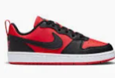
PE
PE days are Wednesday (Swimming) and Thursday PE.
PE Kit
Black or navy plain (no logos) Tracksuit bottoms, joggers, leggings or shorts. Please check shorts are an appropriate length.
House colour school T shirt or plain white T shirt
Black or navy plain (no logos) hoodie or sweatshirt or tracksuit top.
Trainers should be sports shoes, not fashion or casual trainers due to arch supports and better cushioned soles.
Notes:
Please add your dates and delete as appropriate

Slide 9
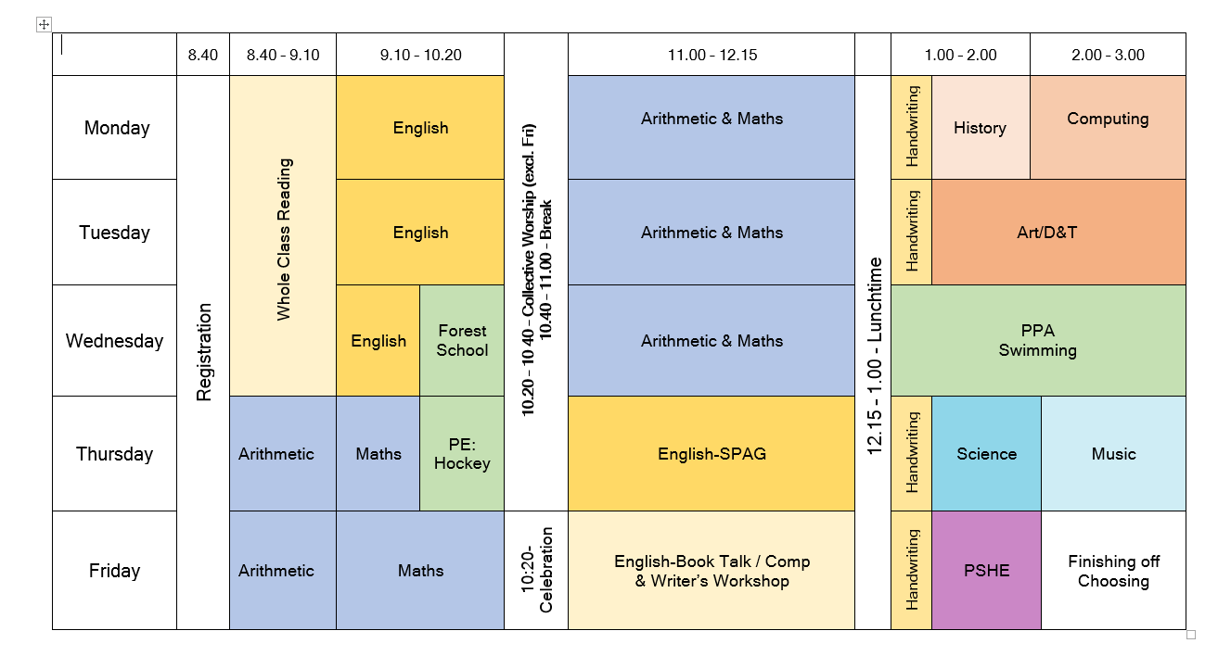
Our weekly timetable

Slide 10
Handwriting and Presentation
There is a big focus on handwriting throughout the school this year and overall presentation of work
Daily handwriting will take place every afternoon at 1pm
We want children to be proud of the work they produce!

Slide 11

Reading expectations
Children are expected to read at home every night
Children need to have an age-appropriate reading book. Children will be supported by their class teacher choosing a book from our key stage 2 reading scheme or our class reading area…..or both!
It is all about reading for pleasure and encouraging our children to be readers for life!
READING
Notes:
Add in about phonics if appropriate

Slide 12
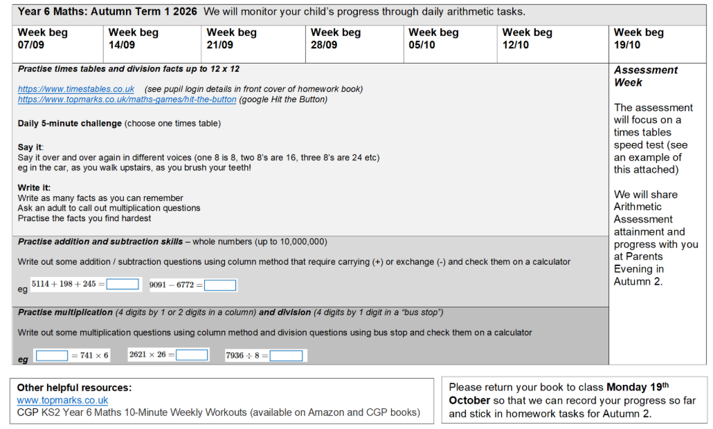
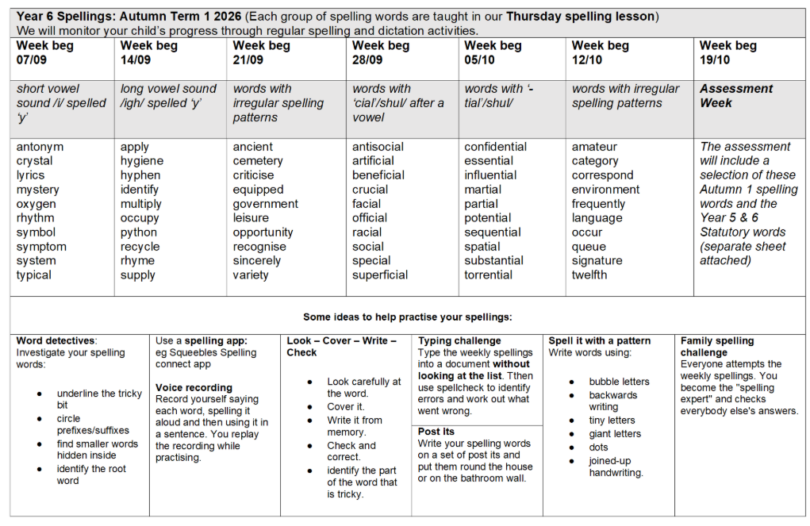
KS2 Homework
This year children will be given a homework book
Inside will be a half termly: spelling and maths sheet
Books will be collected in on Monday 19th October for the new spelling and maths sheets
There will be a list of reading recommendations for children in Year 6
A times table template showing Year 6 expectations to guide home learning
More homework will be sent in the Spring term in preparation for the SATs.

Slide 13
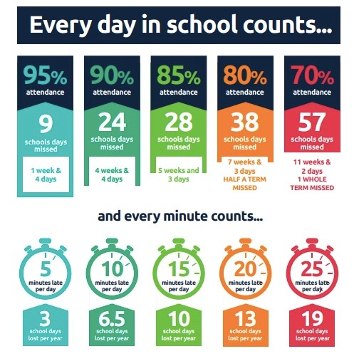
PUNCTUALITY
School day begins at 8.40am
Please come and talk to us if you have any issues with attendance

Slide 14

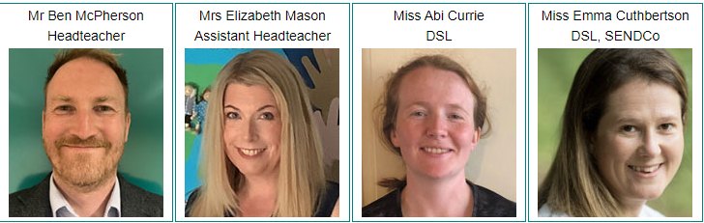


Safeguarding Children - what to do if you think a child is at risk of abuse or neglect:
Immediate danger - if you think a child is in immediate danger, call the police on 999.
Immediate concern - if you have a concern about a child, please call MASH on 0345 050 7666.
A special helpline is available if you are concerned that a child you know is being
sexually exploited. Contact the Kingfisher Team on 01865 309196
Our Designated Safeguarding Leads are:
Safeguarding is Everyone’s Responsibility.
SAFEGUARDING CHILDREN

