Slide 1
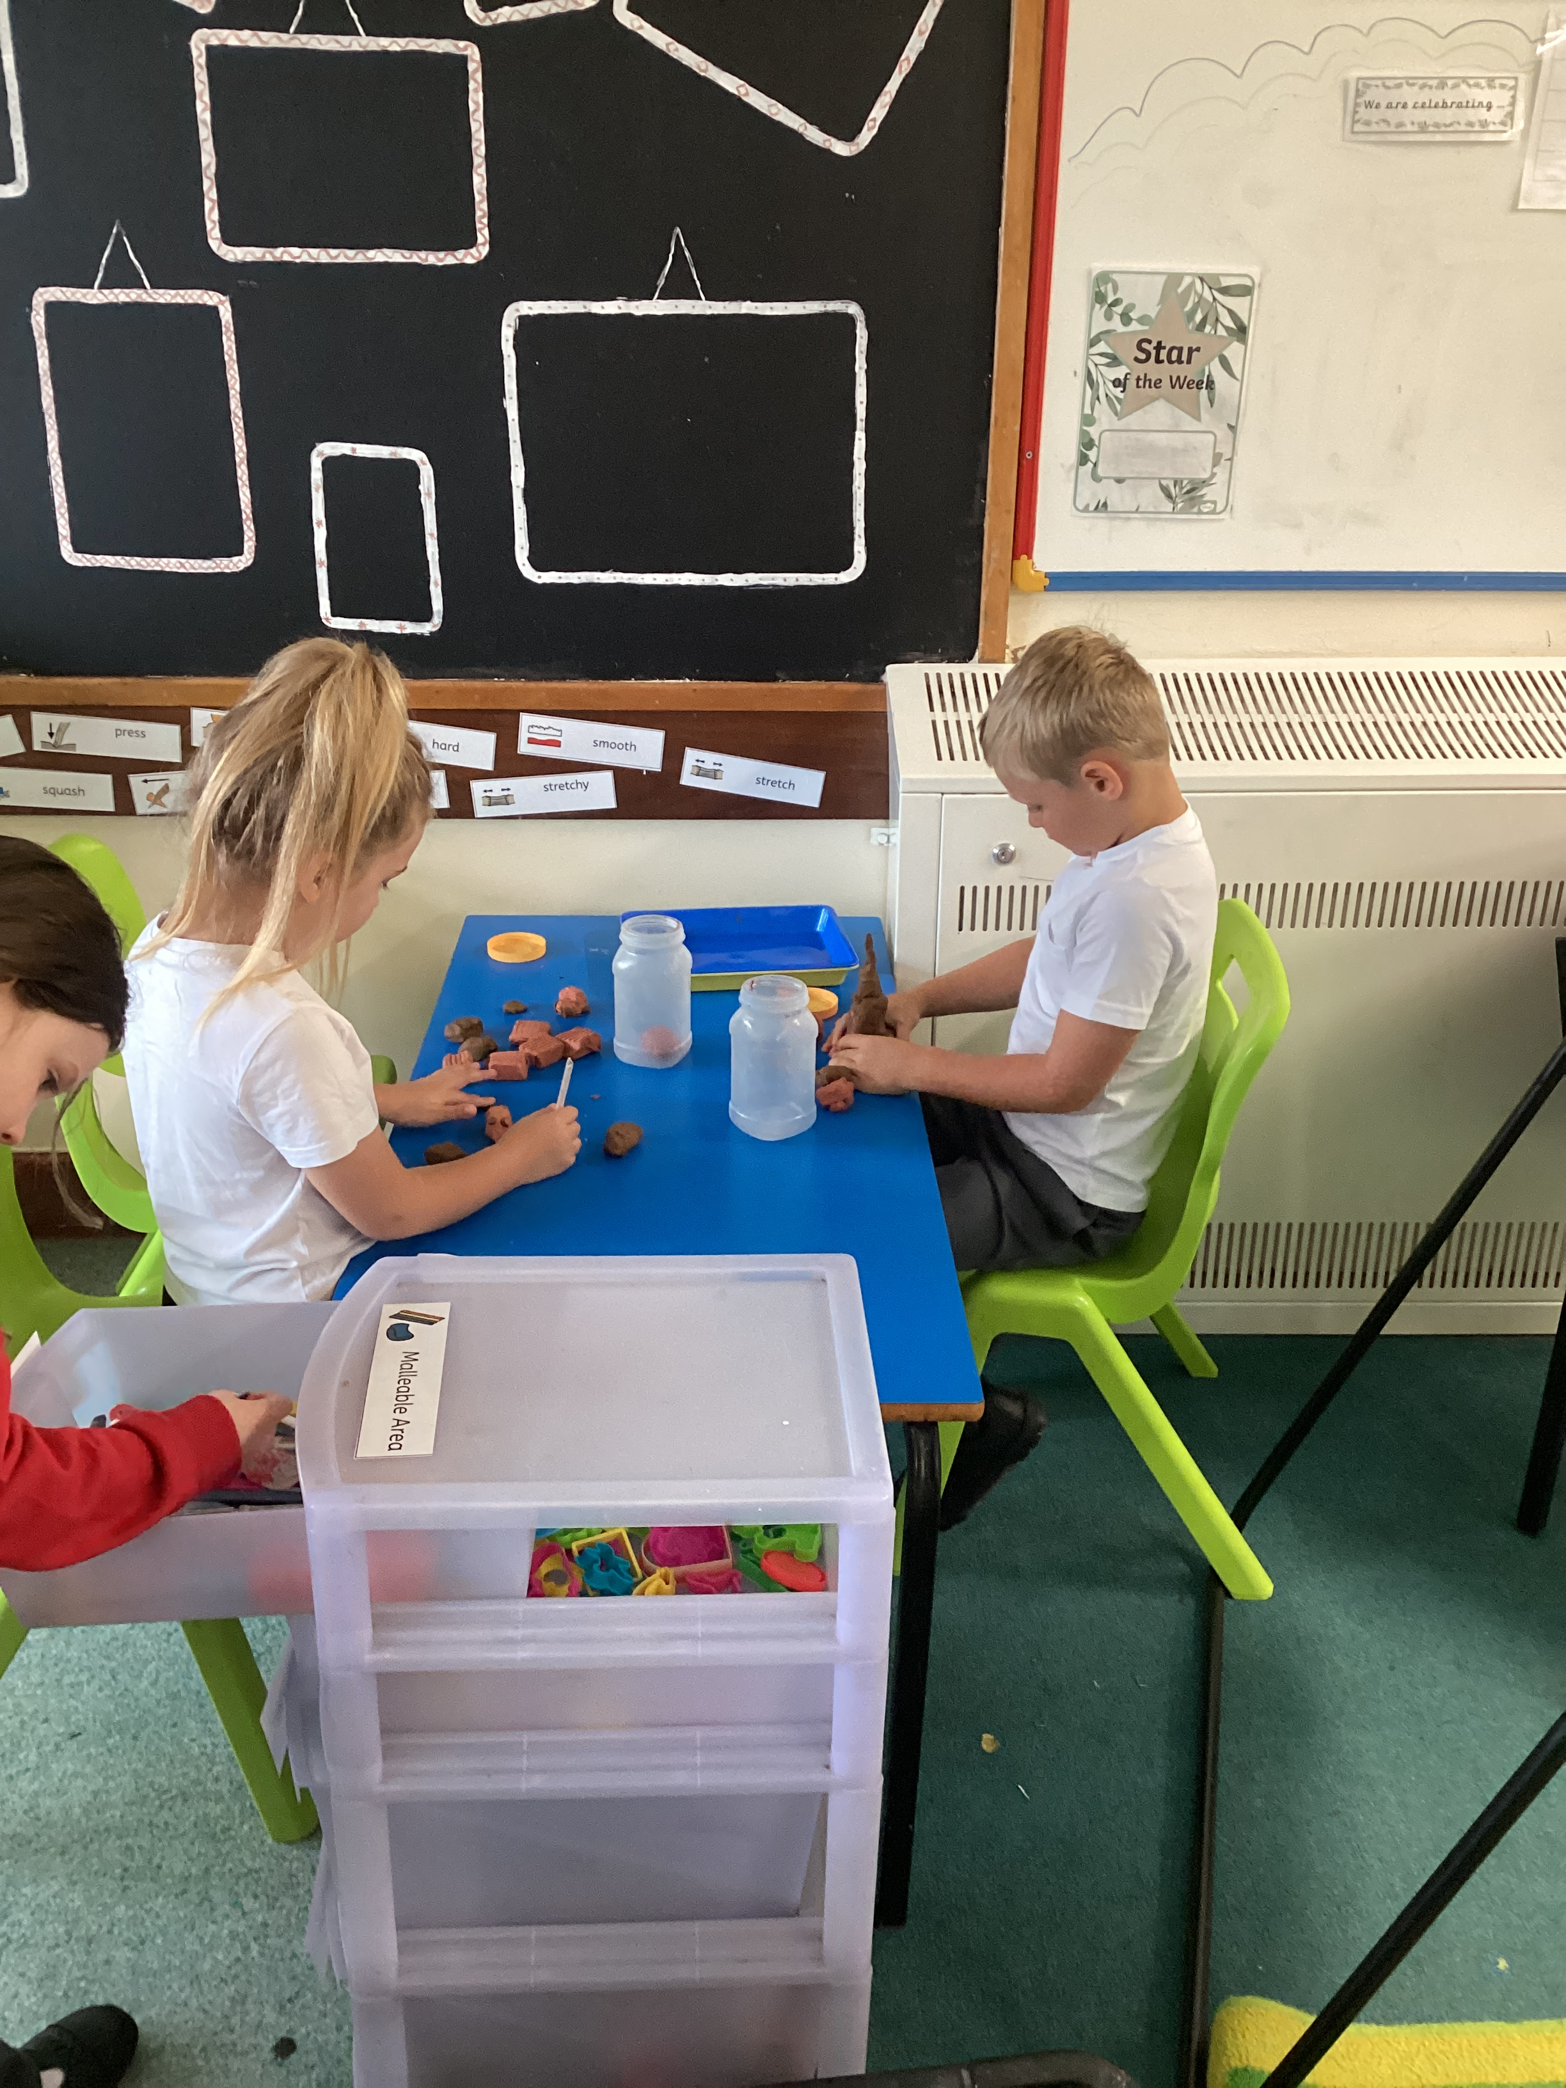
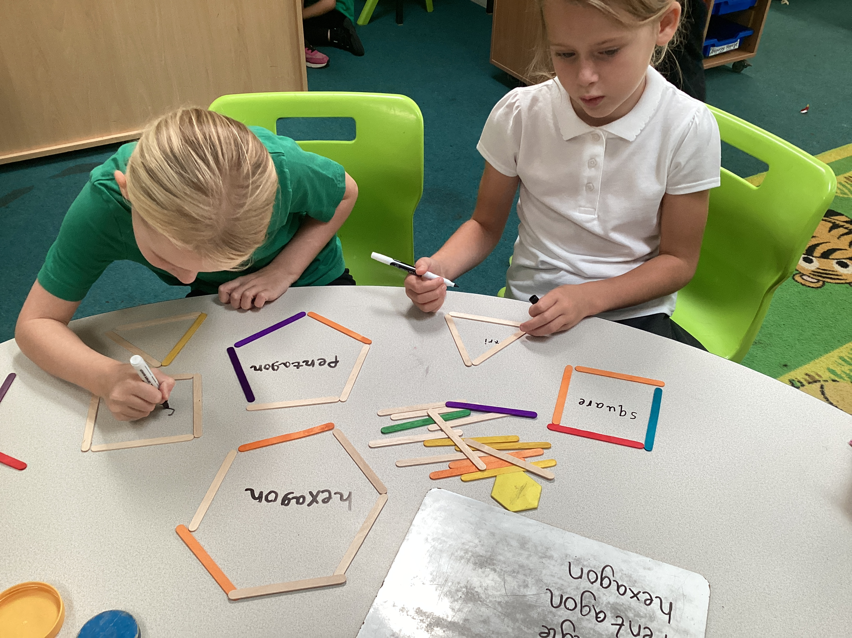
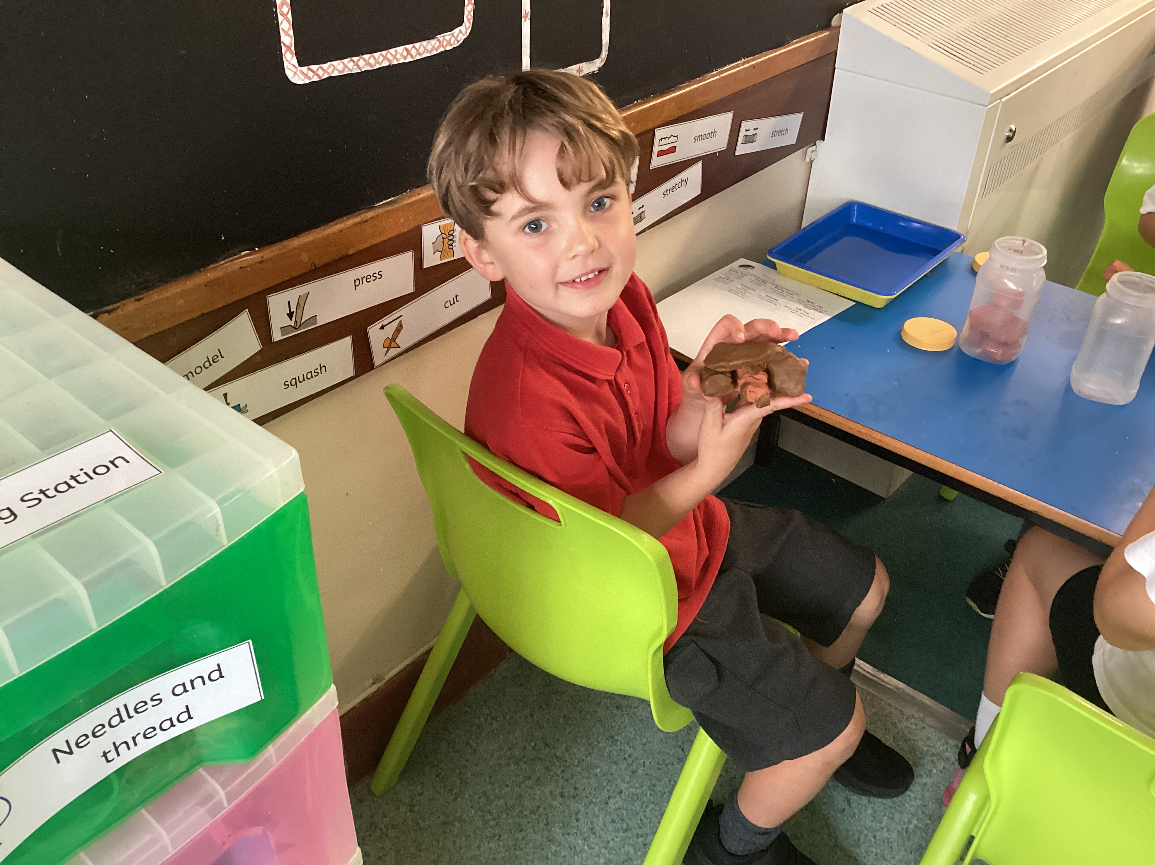
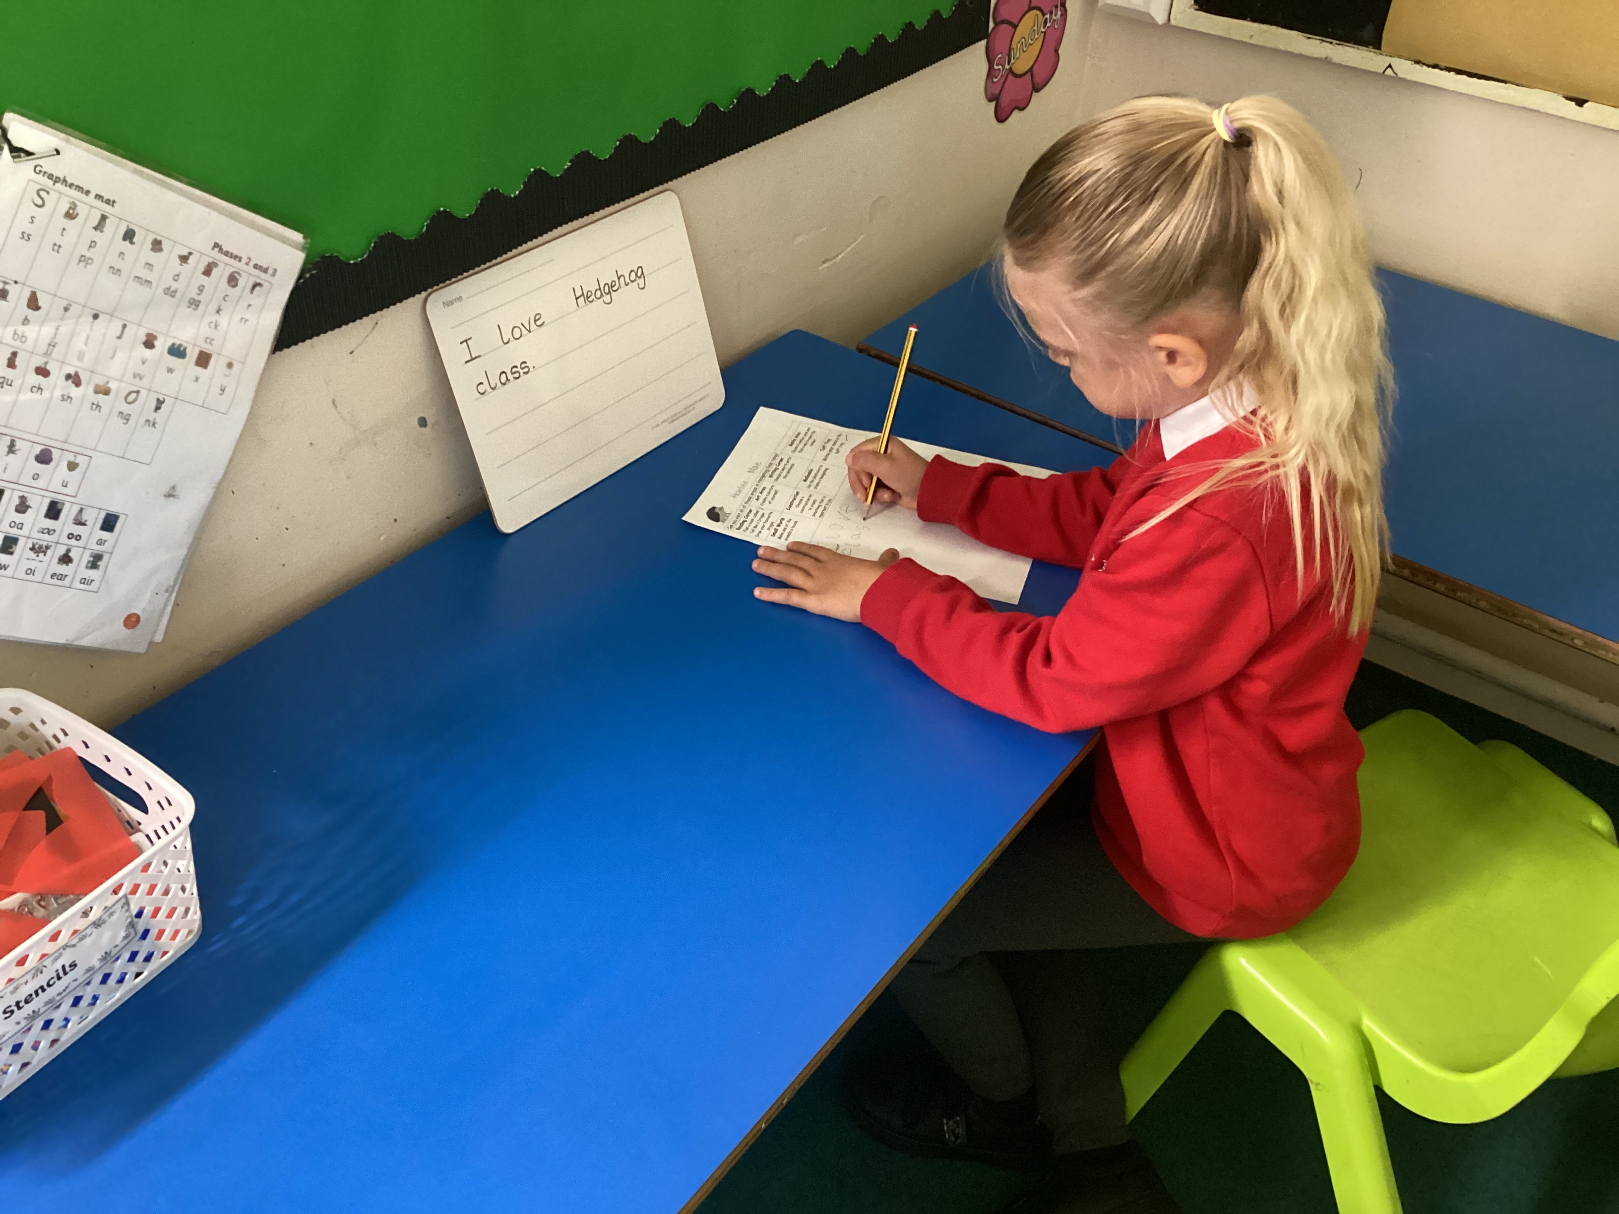
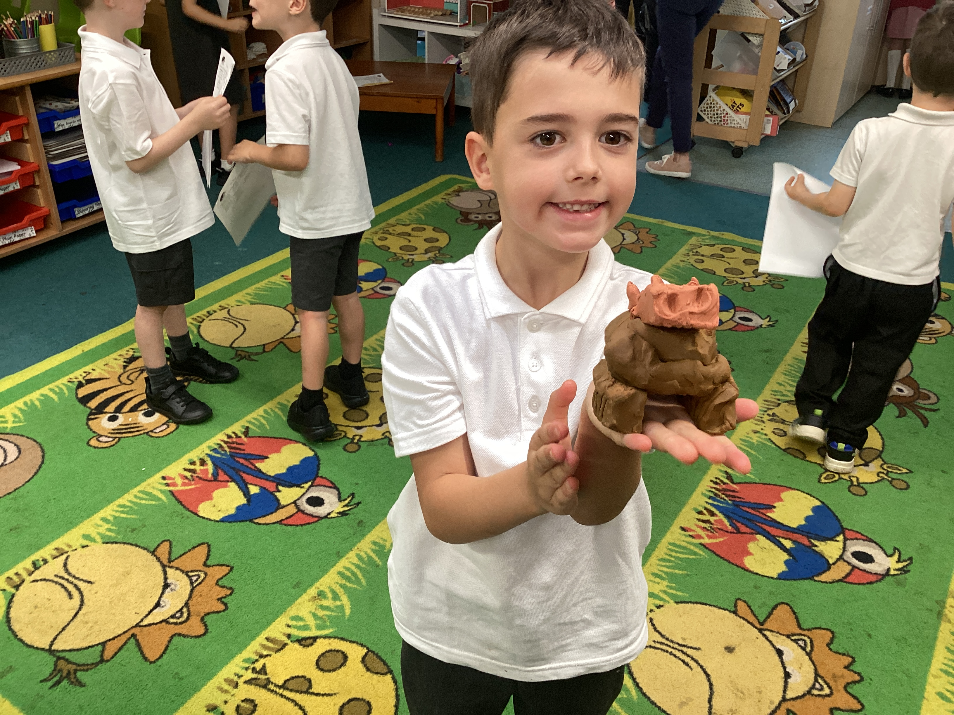
Meet the teacher
Miss Currie Monday
Mrs. Day Tuesday-Friday
hedgehog@north-leigh.oxon.sch.uk
September 2026
Notes:
Class pic here

Slide 2
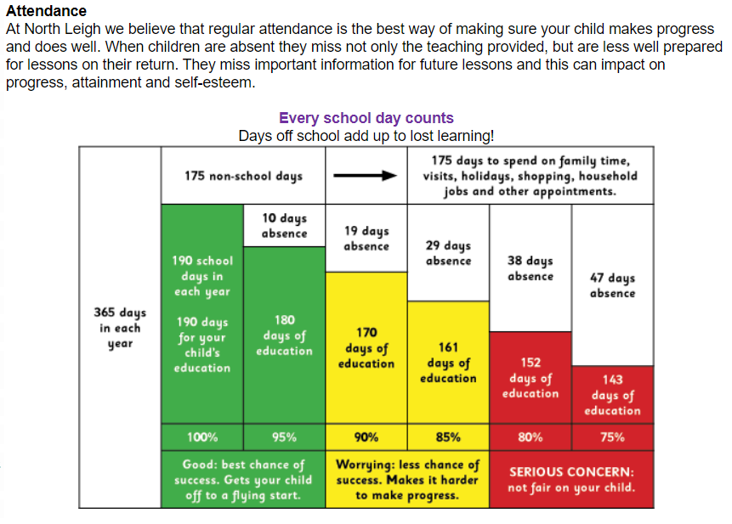
ATTENDANCE
Notes:
Please emphasise that every day counts at school – every second children are here counts.
Attendance is essential to making progress, as is punctuality.
School starts promptly at 8:40am. Inform the school office if your child is unwell as soon as possible or leave a message.
Consult the nhs website if you are unsure whether your child should go to school due to illness.
There are things you can do to improve your child’s attendance and avoid falling
into the persistent absence category:
• Avoid taking any holidays during term times
• Keep up to date with the % attendance your child has so that you know if they are
at risk of persistent absence. Please contact the office or Mrs Hague if you would
like to access this information. This will be shared with you at each parents’ evening
and you will receive a letter in October if your child’s absence has dropped below 90%
• Speak to school staff with any concerns about attendance,
your child’s class teacher or Mrs Hague chague@north-leigh.oxon.sch.uk

Slide 3
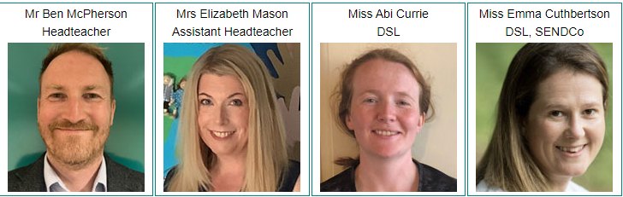



Safeguarding Children - what to do if you think a child is at risk of abuse or neglect:
Immediate danger - if you think a child is in immediate danger, call the police on 999.
Immediate concern - if you have a concern about a child, please call MASH on 0345 050 7666.
A special helpline is available if you are concerned that a child you know is being
sexually exploited. Contact the Kingfisher Team on 01865 309196
Our Designated Safeguarding Leads are:
Safeguarding is Everyone’s Responsibility.
SAFEGUARDING CHILDREN

Slide 4


Daily Routines
Arrival from 8.30am (teachers on playground 8.35am collection at 8.40am from upper playground
Children need to bring a coat, school bag, (lunch bag),
water bottle, homework book & home school reading book
Please ensure children have water in their bottle, not juice.
Break is mid morning and children are can bring in a snack – fruit, vegetables, cereal bar. There is usually free fruit available. Please try to reduce/avoid single-use plastic where possible. Crisps, chocolate or cake bars etc should not be eaten at breaktime.
Nothing with nuts in please: we are a nut-free school.

Slide 5
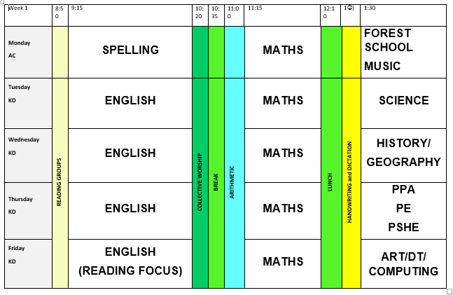

Slide 6

PE
PE days are Monday (Forest School) and Thursday PE.
We are also running the Daily Mile each day. It would be useful for the children to have a pair of trainers in their school bag.
PE Kit
Black or navy plain (no logos) Tracksuit bottoms, joggers, leggings or shorts. Please check shorts are an appropriate length.
House colour school T shirt or plain white T shirt
Black or navy plain (no logos) hoodie or sweatshirt or tracksuit top.
Trainers
Notes:
Please add your dates and delete as appropriate

Slide 7

Reading expectations in Year 2
Children are expected to read at home every night and record in their reading record once a week.
Children will continue to bring home a Little Wandle reading book. During the year, some children will move on to our Banded Book scheme.
Books will be changed on a Friday.
Homework books should be handed in each Friday as well.
READING
Notes:
Add in about phonics if appropriate

Slide 8

Supporting your child.
Model reading yourself including reading aloud. If you read aloud, it helps your child to hear what it should sound like when they read.
Read regularly with your child, even if they are confident, so you can discuss themes and plots within the book.
Discuss unfamiliar vocabulary and help your child use clues to work out possible meaning from the context.
Help them find precise evidence to support what they are talking about rather than vague comments or I like this character best because he/she is funny and stuff.
Encourage them to read often and help make it a habit.

Slide 9
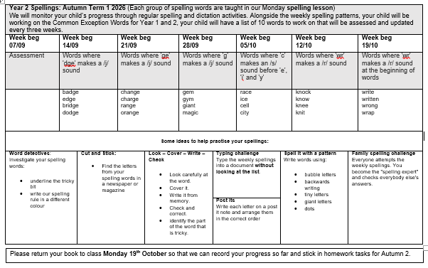

Spelling Homework

Slide 10
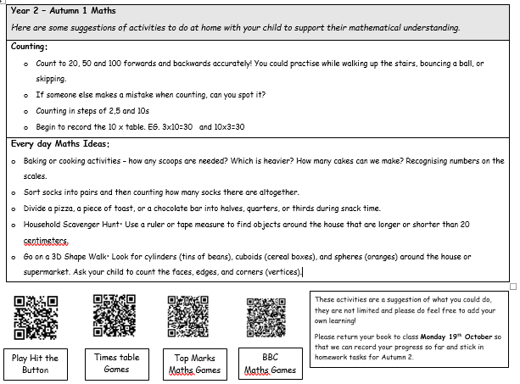
Maths TABLES Homework
.

Slide 11

SCHOOL DEVELOPMENT
Notes:
This year we are working with all children on zones of regulation.
Explain the strategies that children have been introduced to already and what has been discussed in your class.

Slide 12





Our emphasis is on children ‘making a positive difference in our world’
New values are LOVE, PERSEVERANCE, RESPECT and FLOURISHING COMMUNITY
One value as a focus per long term, with FLOURISHING COMMUNITY woven through everything we do.
SCHOOL DEVELOPMENT
Notes:
Vision and values
We have revisited our strapline and values to reflect the changing demographic of our school.
Emphasis on children ‘making a positive difference in our world’
New values are LOVE, PERSEVERANCE, RESPECT and FLOURISHING COMMUNITY
One value as a focus per long term, with FLOURISHING COMMUNITY woven through everything we do.

Slide 13
We’re looking forward to sharing our love of learning with you.
This will be through:
galleries on our class website pages
Friday Newsletters with photos from each class every other week on the school website.
We are also excited by our forthcoming Reading café on when parents are invited to come and enjoy coffee, cake, and share books with your child.
Year 2 will also perform in a Nativity in December. Look out for dates in the newsletters.
CELEBRATING LEARNING

