Slide 1
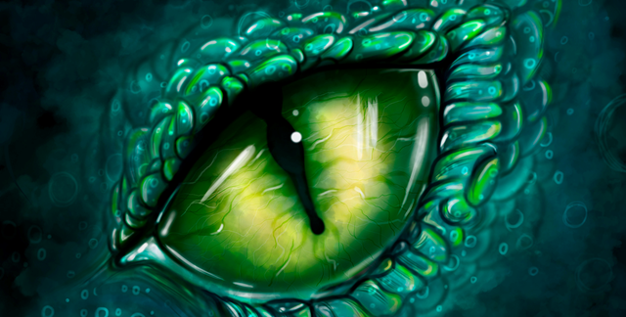






Hedgehog Class
Year 2
Autumn Term 2025
TOPIC & SCIENCE
In History , we will be learning about The Battle of Hastings. We will find out why the battle took place as well as using the Bayeux Tapestry to retell the story. Then we will find out why castles were built and the different types of castles.
In Science, we will learn about materials. We will identify and compare the suitability of a variety of everyday materials, including wood, metal, plastic, glass, brick, rock, paper and cardboard for particular uses.
We will plan and carry out simple comparative tests and use observations and ideas to suggest answers to questions.
ENGLISH
Class text: Tell Me a Dragon
George and the Dragon
Character Descriptions: We will learn about nouns, verbs and adjectives. We will then write a character description about a dragon.
Explanation Text: We will also look at explanation texts and explain how to look after a dragon.
Traditional Stories: We will write our own versions of George and the Dragon.
Persuasive Texts: We will to persuade people to visit Oxford Castle.
MATHEMATICS
Key areas of learning over the term will include:
Place Value:
Counting forwards and backwards in steps of 2,5,10 and 3
Read and write numbers to 100
Separate numbers into tens and ones
Compare numbers using the <>= symbols.
Addition and Subtraction:
Recall facts to 20: Fluently recall and use addition and subtraction facts up to 20
Derive facts up to 100: Use known relationships to figure out facts up to 100.
A two-digit number and ones (e.g., 45 + 3 or 45 - 3)
A two-digit number and tens (e.g., 45 + 30 or 45 - 30)
Two two-digit numbers (e.g., 45 + 23 or 45 - 23)
Adding three one-digit numbers (e.g., 6 + 4 + 7)
Shape and Space:
Recognising and sorting 2D and 3D shapes. Counting the edges, corners and vertices of 3D shapes.
RE
PSHE
Islam: Belief and Practice
Does praying at regular intervals help a Muslim in his/ her everyday life?
Incarnation (UC)
Why does Christmas matter to Christians?
Being Me in my World
We will be learning about our roles and
as well as recognising our own and
others strengths.
E-SAFETY & COMPUTING
MUSIC
In Computing we will understand what information technology (IT) is and begin to identify examples. We will also explain the importance of using IT responsibly. Then we will learn how to take photographs as well as how to use tools to edit them.
Hands, Feet, Heart
We will be learning to keep a steady beat and create simple rhythms.
CURRICULUM ENRICHMENT
Visit to Cogges Farm
Harvest Festival
Anti Bullying Week
Visit to Oxford Castle
KS1 Nativity
Panto Visit
Hockey
We will be learning how to dribble, pass, shoot and tackle in hockey and football. We will begin to take part in small sided games.
Clay Dragon Eyes and Castles
In art, we are going to explore clay, learning to make a pinch pot and join clay using the slip and score method. We will also find different ways to make marks on the clay. In DT , we will be learning how to make simple mechanisms whilst building a castle with a working draw bridge.
PE & OUTDOOR LEARNING
ART & DT

