Slide 1
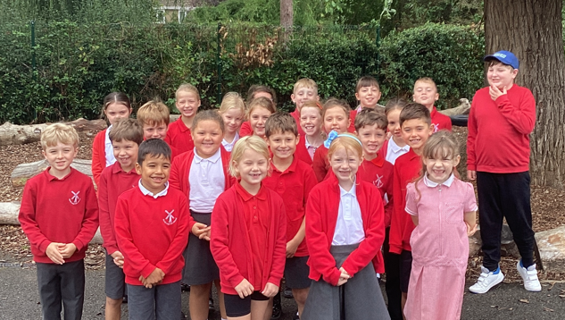
Meet the teacher
Mrs. Prior
September 2026
Notes:
Class pic here

Slide 2
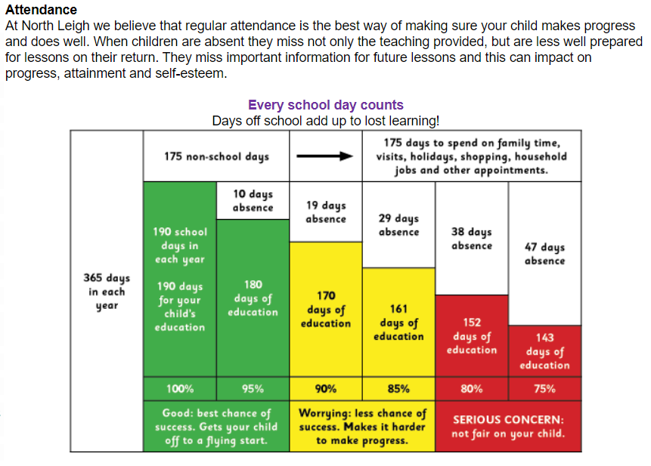
ATTENDANCE
Notes:
Please emphasise that every day counts at school – every second children are here counts.
Attendance is essential to making progress, as is punctuality.
School starts promptly at 8:40am. Inform the school office if your child is unwell as soon as possible or leave a message.
Consult the nhs website if you are unsure whether your child should go to school due to illness.
There are things you can do to improve your child’s attendance and avoid falling
into the persistent absence category:
• Avoid taking any holidays during term times
• Keep up to date with the % attendance your child has so that you know if they are
at risk of persistent absence. Please contact the office or Mrs Hague if you would
like to access this information. This will be shared with you at each parents’ evening
and you will receive a letter in October if your child’s absence has dropped below 90%
• Speak to school staff with any concerns about attendance,
your child’s class teacher or Mrs Hague chague@north-leigh.oxon.sch.uk

Slide 3
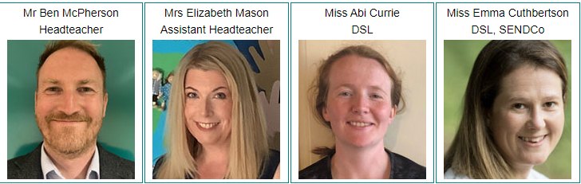



Safeguarding Children - what to do if you think a child is at risk of abuse or neglect:
Immediate danger - if you think a child is in immediate danger, call the police on 999.
Immediate concern - if you have a concern about a child, please call MASH on 0345 050 7666.
A special helpline is available if you are concerned that a child you know is being
sexually exploited. Contact the Kingfisher Team on 01865 309196
Our Designated Safeguarding Leads are:
Safeguarding is Everyone’s Responsibility.
SAFEGUARDING CHILDREN

Slide 4
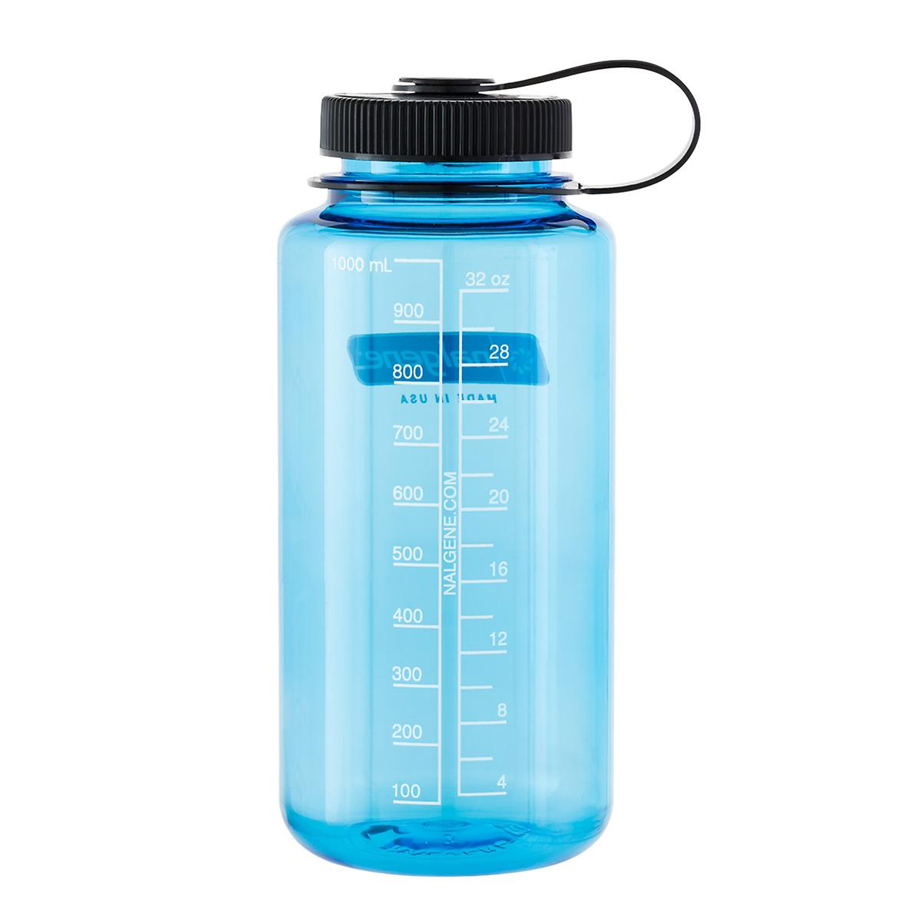

Daily Routines
Arrival from 8.30am (teachers on playground 8.35am collection at 8.40am from playground
Children need to bring a coat, school bag, (lunch bag),
water bottle & home school reading book
Please ensure children have water in their bottle, not juice.
Break is mid morning and children are can bring in a snack – fruit, vegetables, cereal bar. Please try to reduce/avoid single-use plastic where possible. Crisps, chocolate or cake bars etc should not be eaten at breaktime.
Nothing with nuts in please: we are a nut-free school.

Slide 5

PE
PE days are Tuesday and Friday. PE days may change after half term.
PE Kit
Black or navy plain (no logos) Tracksuit bottoms, joggers, leggings or shorts. Please check shorts are an appropriate length.
House colour school T shirt or plain white T shirt
Black or navy plain (no logos) hoodie or sweatshirt or tracksuit top.
Trainers should be sports shoes, not fashion or casual trainers due to arch supports and better cushioned soles.
Notes:
Please add your dates and delete as appropriate

Slide 6

READING
Reading expectations
Children are expected to read at home every night
Children need to have an age-appropriate reading book. Children will be supported by their class teacher choosing a book from our key stage 2 reading scheme.
Notes:
Add in about phonics if appropriate

Slide 7

Supporting your child.
Model reading yourself including reading aloud. If you read aloud, it helps your child to hear what it should sound like when they read.
Read regularly with your child, even if they are confident, so you can discuss themes and plots within the book.
Discuss unfamiliar vocabulary and help your child use clues to work out possible meaning from the context.
Help them find precise evidence to support what they are talking about rather than vague comments or I like this character best because he/she is funny and stuff.
Encourage them to read often and help make it a habit.

Slide 8
Homework
📖 Reading – Reading every night helps build confidence, vocabulary and understanding. Strong reading skills support learning across the whole curriculum.
🔤 Spelling – Regular practice helps children become more confident and accurate writers. A list of the spellings for the term, along with Year 3 and 4 statutory spellings and a reminder of the Year 1 and 2 common exception words will come out in your child’s homework book, along with ideas to support regular practise.
✖️ Times Tables – Quick recall of times tables supports fluency and confidence across maths. Year 4 children will also complete the Multiplication Tables Check in the summer term, further details to follow. Homework will also include some ideas to practise key numeracy skills with website links if you prefer.
Times Tables Practice:
Children will use TimesTables.co.uk to practise through a range of games. They will be shown how to log in and use the platform. Login details will be sent home in homework books.
Please return Homework books to class Monday 19th October so that we can record progress so far and stick in homework tasks for Autumn 2.

Slide 9
Collective worship
These have a weekly focus
Mondays: Whole School Worship led by Mr McPherson
Tuesdays: Church Worship led by Rev Margaret
Wednesdays: Singing Worship
Thursdays: Class Worship led by class teachers
Fridays: Celebration Worship for the whole school
Café assemblies will happen 3 x a year for each class – please check the newsletter and communications for when these are. Our first class assembly will be a reading assembly where you will have an opportunity to come into school and read with your child.

Slide 10
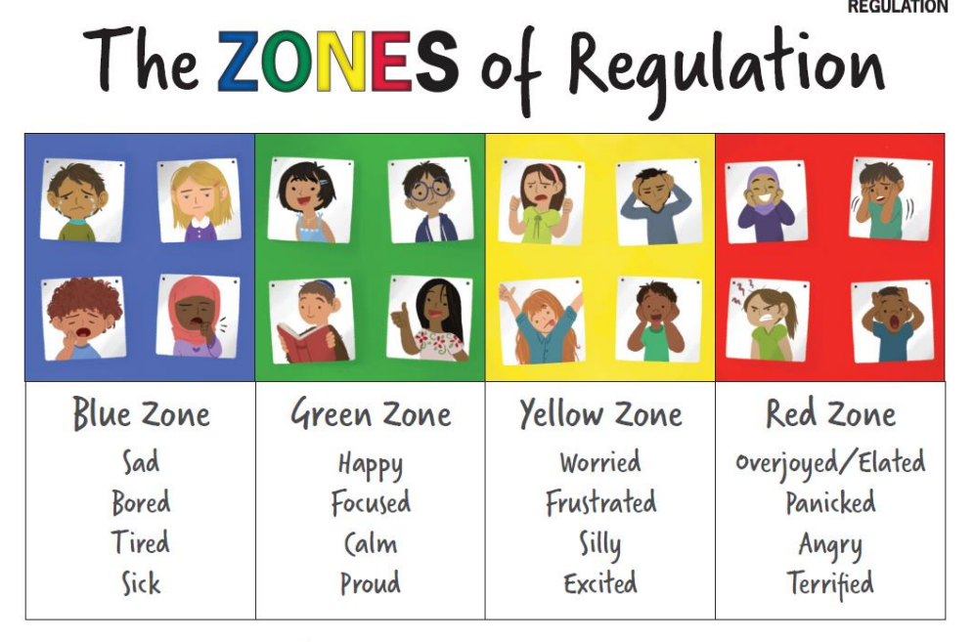
Notes:
This year we are working with all children on zones of regulation.
Explain the strategies that children have been introduced to already and what has been discussed in your class.

Slide 11





Our emphasis is on children ‘making a positive difference in our world’
Our values are LOVE, PERSEVERANCE, RESPECT and FLOURISHING COMMUNITY
One value as a focus per long term, with FLOURISHING COMMUNITY woven through everything we do.
SCHOOL DEVELOPMENT
Notes:
Vision and values
We have revisited our strapline and values to reflect the changing demographic of our school.
Emphasis on children ‘making a positive difference in our world’
New values are LOVE, PERSEVERANCE, RESPECT and FLOURISHING COMMUNITY
One value as a focus per long term, with FLOURISHING COMMUNITY woven through everything we do.

Slide 12
CELEBRATING LEARNING
We’re looking forward to sharing our love of learning with you.
This will be through:
galleries on our class website pages
Newsletters with photos and news on the school website.
Admin newsletters and messages.
Instagram posts with photos of exciting learning opportunities in school.

Slide 13
Any questions?
If there is something you would like to discuss confidentially, please remain at the end of the presentation for a brief chat, or we could make an appointment to discuss anything further.

