Slide 1
LKS2
Reading Workshop
Friday 16th October 2026

Slide 2
Aims
To explain how we teach reading and comprehension in KS2
To give ideas to how you can support your child at home

Slide 3
Why the focus on reading for pleasure?
Reading for pleasure is more important for children's cognitive development than their parents' level of education and is a more powerful factor in life achievement than socio-economic background.
Children who read books often at age 10 and more than once a week at age 16 gain higher results in Maths, vocabulary and spelling tests at age 16 than those who read less regularly.
“Evidence suggests that reading for pleasure is an activity that has emotional and social consequences” (Clark and Rumbold, 2006).
Having books in the home is associated with both reading enjoyment and confidence. Of children who report having fewer than 10 books in their homes, 42% say they do not like reading and only 32% say they are 'very confident' readers. For children who report having over 200 books at home, only 12% say they do not like reading and 73% consider themselves 'very confident' readers.

Slide 4

How do we teach and promote reading at North Leigh?
Reading awards
Arch readers
Story time
Celebrating events such as book weeks and
World Book Day
Whole class reading sessions
High quality class texts
Regular library visits
Individual reading, including parent volunteers
Continued phonic support if necessary
Author visits

Slide 5
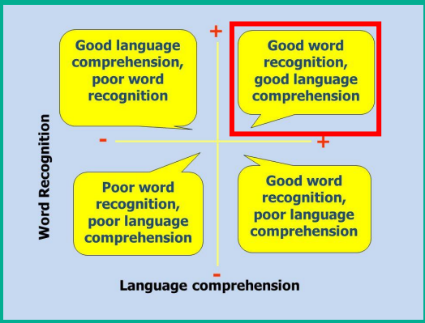
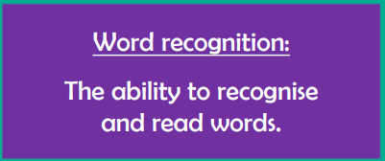
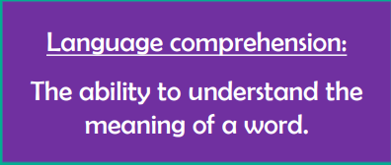

Slide 6
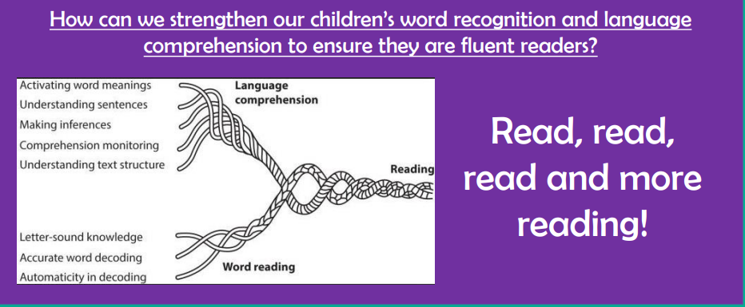
Word Reading
Notes:
https://www.phonicbooks.co.uk/2023/01/24/teaching-the-rope/

Slide 7
Reading Fluency
Fluency is a child’s ability to read a book or other text with accuracy, at a reasonable rate, and with appropriate expression. Reading fluency is important because it provides a bridge between word recognition and comprehension.
Partner Reading
You and your child take turns reading. Select reading material that is at your child’s success level. You are the model for both fluency and personal expression.
Choral Reading
You and your child read together at the same time. You should be slightly ahead (i.e., a couple of milliseconds) of your child. Even though it appears that the reading is happening simultaneously, you are actually leading and your child is following.
Model
Read aloud to your child to provide a good example of fluent reading. Make it fun by using an expressive voice and intonation.
Repetition
  Once you have complied reading material, encourage your child to reread his favorites. Try to make it fun! This could include reading in a different location (e.g., on a swing or in the bath) or using different voices.
  Repeated readings not only improve fluency, but comprehension and using intonation as well.

Slide 8

What do Whole Class Reading lessons look like?
Good quality class texts are carefully chosen by the teacher.
Children are then taught reading skills, by the teacher, every day.
Teachers follow structured weekly plans, and are able to develop various aspects of reading and comprehension skills with the whole class.
Reading fluency is also taught.
Teachers carefully select vocabulary words they want the children to learn that week. These will be taught, over learnt and embedded throughout the rest of the week during comprehension sessions and across the wider school day to allow for children to use these words in different contexts.
Teachers will cover both fiction
and non-fiction texts.

Slide 9
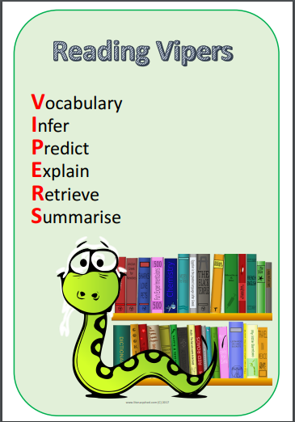
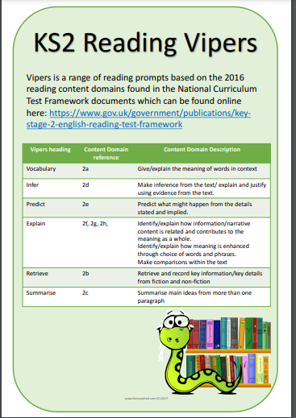

Slide 10

How can you support your child at home?
Being a role model – get caught reading!
Read, read, and read some more!
Enjoying a wide range of materials: Picture books (all ages!) Newspapers Magazines and Audio books
Hear your child read (Daily - Reading Diaries)
Support them in choosing new books to read
Encourage wide reading – range of genres
Asking effective questions
Your child is never too old to read to you or for you to read to them!

Slide 11
Further Support
The School Reading List
Book Trust
TES 100 Fiction Books All Children Should Read
Let’s Read!

